Slide 1
WATER QUALITY CLASSIFICATION USING LOGISTIC REGRESSION AND DECISION TREES
Team Members Details
2520090142 – Surendra
2520080041 – Satwick
2520090091 - Rohit
Guided By: Sai Lakshmi Haritha

Slide 2
Contents
Project Title and Team Members
Abstract
Problem Statement
Motivation
Objectives

Slide 3
Literature Survey
Research Gap
Proposed Methodology
System Architecture
Technologies Used

Slide 4
Dataset / Input Details
Implementation
Experimental Setup
Results
Performance Evaluation

Slide 5
Screenshots / Working Demo
Comparison with Existing System
Challenges and Solutions
Future Work
Conclusion
References

Slide 6
Future Work
Conclusion
References

Slide 7
Abstract
This study compares Logistic Regression and Decision Trees for water potability classification using physicochemical parameters. Decision Trees achieve superior accuracy by capturing nonlinear patterns, offering a reliable water safety solution.

Slide 8
Problem Statement
Conventional water quality assessment relies on slow, expensive laboratory testing, causing delayed contamination detection and serious waterborne health hazards. This creates an urgent necessity for automated, rapid machine learning classification.

Slide 9
Motivation
Protecting public health from waterborne diseases drives this project. Deploying machine learning empowers treatment facilities with rapid, automated potability predictions, transforming complex physicochemical data into proactive safeguards for drinking water.

Slide 10
Objectives
Train and compare Logistic Regression and Decision Trees using physicochemical parameters. Evaluate classification performance through accuracy, precision, and recall. Develop an automated, reliable machine learning framework for drinking water safety.

Slide 11
Literature Survey
Existing literature highlights limitations of manual laboratory water testing. Recent studies demonstrate machine learning effectiveness, where linear models offer interpretability while decision trees better capture complex, nonlinear environmental feature interactions.

Slide 12
Research gap
Current methods often rely on slow testing or fail to model complex, nonlinear physicochemical interactions, lacking comparative evaluations between interpretable baselines and decision trees for continuous water potability classification systems.

Slide 13
Proposed Methodology
The proposed methodology preprocesses physicochemical parameters, trains and validates Logistic Regression and Decision Tree algorithms, and evaluates their predictive accuracy, precision, and recall to classify drinking water potability with reliability.

Slide 14
System Architecture
The system architecture consists of data ingestion for physicochemical parameters, a preprocessing pipeline, model training using Logistic Regression and Decision Trees, performance evaluation modules, and an automated potability classification output.

Slide 15
Technologies used
This project utilizes Python with Jupyter Notebook and VS Code, leveraging core libraries including NumPy, Pandas, Scikit-Learn, Matplotlib, and Seaborn to implement, train, and evaluate Logistic Regression and Decision Trees.

Slide 16
Dataset / input details
The input dataset comprises environmental water records featuring key physicochemical parameters, including pH levels, turbidity, hardness, solids, and chemical contaminants, used to predict a binary target determining drinking water potability.

Slide 17

Implementation

Slide 18
Experimental setup
Experiments were conducted in Python using Jupyter Notebook. Preprocessed water data was partitioned for training and testing, benchmarking Logistic Regression against Decision Trees using accuracy, precision, recall, and F1 scores.

Slide 19
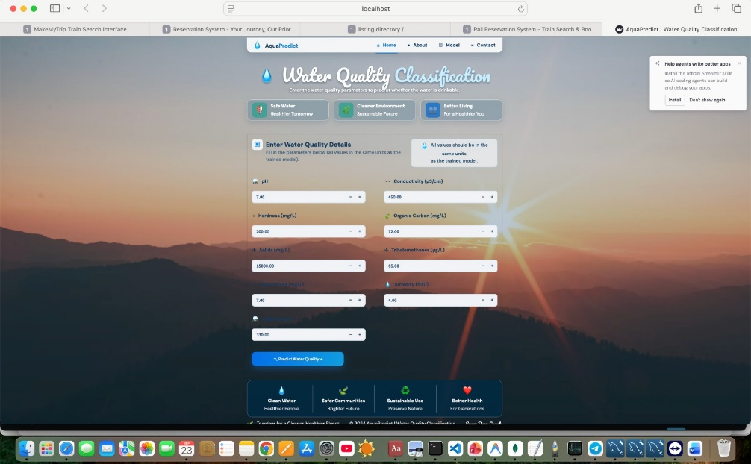
Results

Slide 20
Performance Evaluation
Models were evaluated using accuracy, precision, recall, and F1 scores. While Logistic Regression provided computational efficiency, the Decision Tree achieved superior overall classification performance by successfully capturing nonlinear feature interactions.

Slide 21
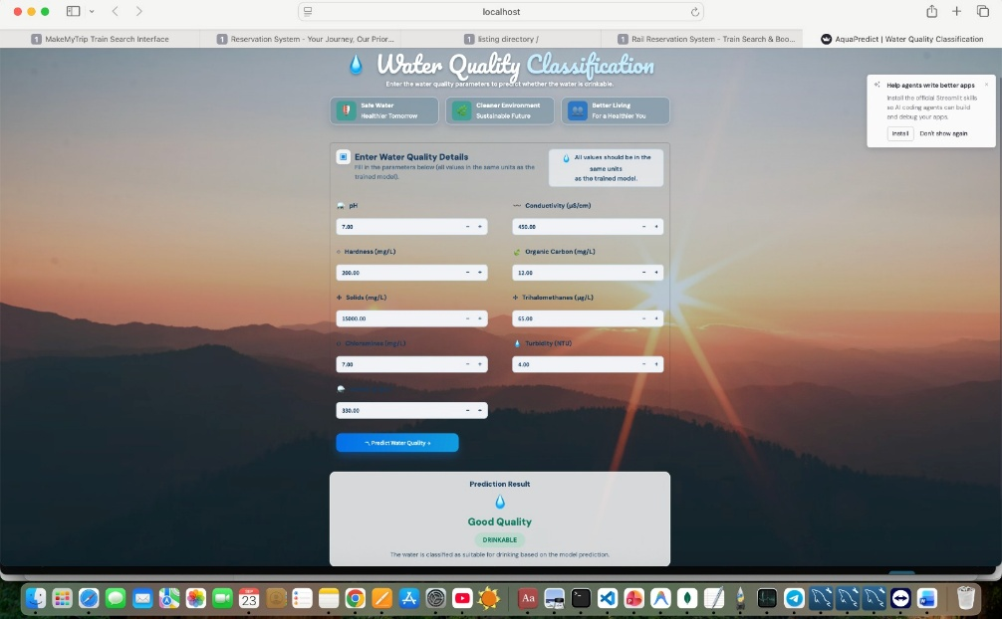
Screenshots / Working demo

Slide 22
Comparison with Existing System
Unlike existing manual laboratory methods that are slow, expensive, and delayed, the proposed machine learning system provides rapid, automated, and scalable potability classification, enabling swift contamination detection for public safety.

Slide 23
Challenges and solutions
Challenges: Water parameters exhibit complex, nonlinear interactions that limit linear classifiers. Solution: Deploying Decision Tree algorithms captures hierarchical threshold rules and intricate patterns, ensuring accurate, reliable drinking water potability classification.

Slide 24
Future work
Future work involves integrating IoT sensors for continuous water monitoring, exploring advanced ensemble models like Random Forests, and expanding the dataset to include diverse geographic sources and microbiological contamination indicators.

Slide 25
Conclusion
This research demonstrates that Decision Trees outperform Logistic Regression in drinking water potability classification, establishing a scalable, automated framework to empower treatment facilities, detect contamination swiftly, and safeguard public health.

Slide 26
References
World Health Organization, Guidelines for Drinking Water Quality, Geneva, 2017. Pedregosa et al., Machine Learning in Python, JMLR, 2011. Breiman et al., Classification and Regression Trees, CRC Press, Florida, 1984.

